Slide 1
Linux File system System Calls

Slide 2
Opn on files: create, read, write,delete, truncate, repositioning
File attr: name, extension(type), identifier, location,size, created date, permission, encryption, compression

Slide 3
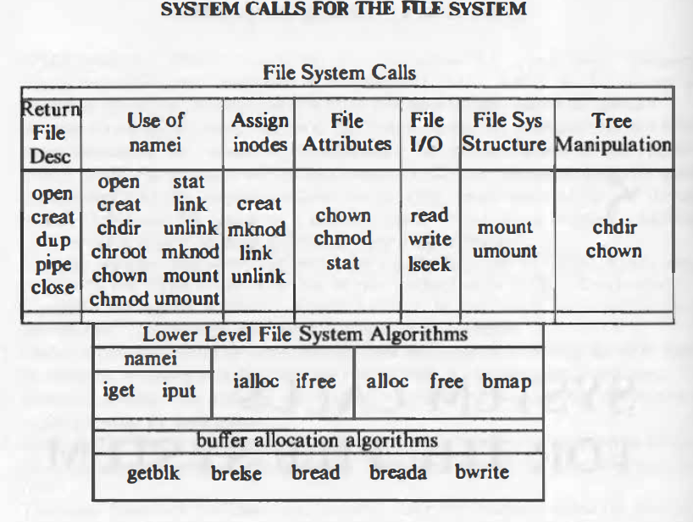
Super block
consists of
- the size of the file system
- the number of free blocks in the file system
- a list of free blocks available on the file system
- the index of the next free block in the free block list
- the size of the inode list
- the number of free inodes in the file system
- a list of free inodes in the file system
- the index of the next free inode in the free inode list
- lock fields for the free block and free inode lists
- a flag indicating that the super block has been modified

Slide 4
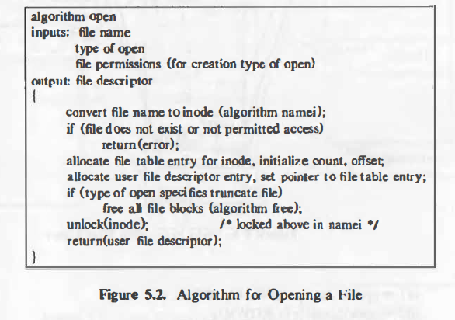
Algorithm for open

Slide 5

Open
Fd=open(pathname, flags, modes);
Pathname : file name
Flags : type of the open
Modes : file permission (esp for creat)
Returns an integer called the user file descriptor

Slide 6
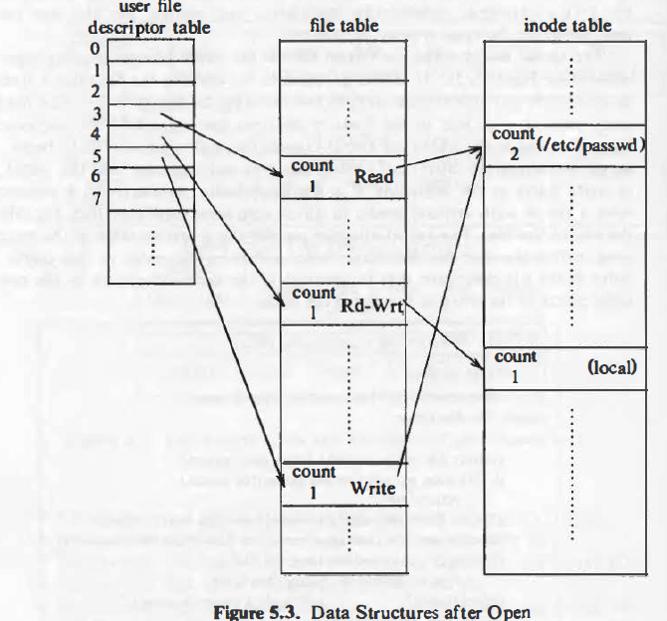
Data structures for open

Slide 7
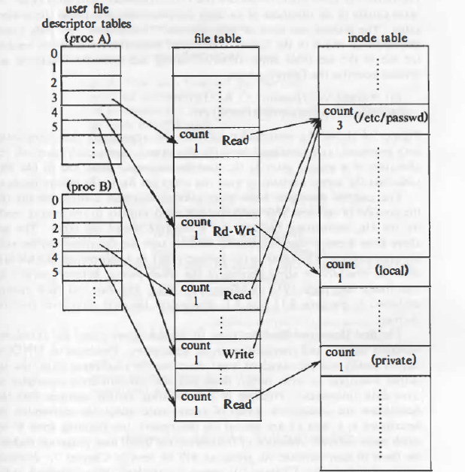
Process B: fd1= open(''/etc/passwd", O_RDONLY); fd2 ,.,. open("private", O_RDONLY);
Process A:

Slide 8
Read
The syntax of the read system call is
number = read(fd, buffer, count)
-fd is the file descriptor returned by open
-buffer is the address of the data structure
-Count is the number of bytes the user wants to read
-number is the number of bytes actually read

Slide 9
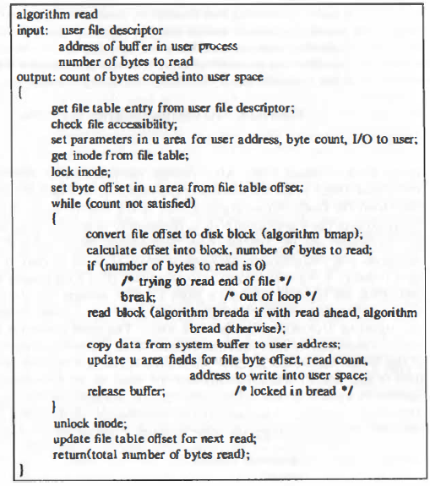

Slide 10
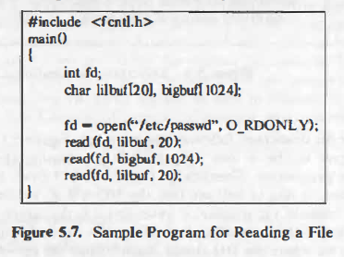

Slide 11
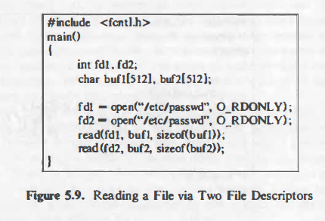

Slide 12
Write() system call
The syntax for the write system call is
number = write(fd, buffer, count);
where the meaning of the variables fd, buffer, count, and number are the same as they are for the read system call.
The algorithm for writing a regular file is similar to that for reading a regular file.

Slide 13
Create()
The creat system call creates a new file in the system. The syntax for the creat system call is
fd - creat(pathname, modes) ;
Where the variables pathname, modes, and fd mean the same as they do in the open system call.

Slide 14
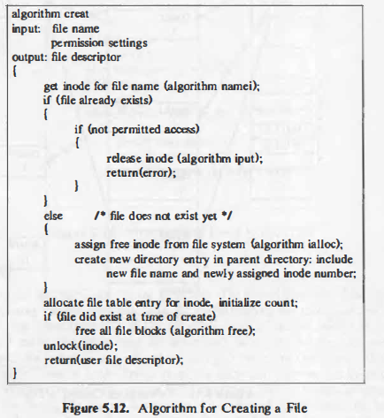

Slide 15
Close()
The syntax for the close system call is
close(fd);
where fd is the file descriptor for the open file.
The kernel does the close operation by manipulating the file descriptor and the corresponding file table and inode table entries. If the reference count of the file table entry is greater than 1

Slide 16
Process B: fd1= open(''/etc/passwd", O_RDONLY); fd2 ,.,. open("private", O_RDONLY);
Process A:

Slide 17
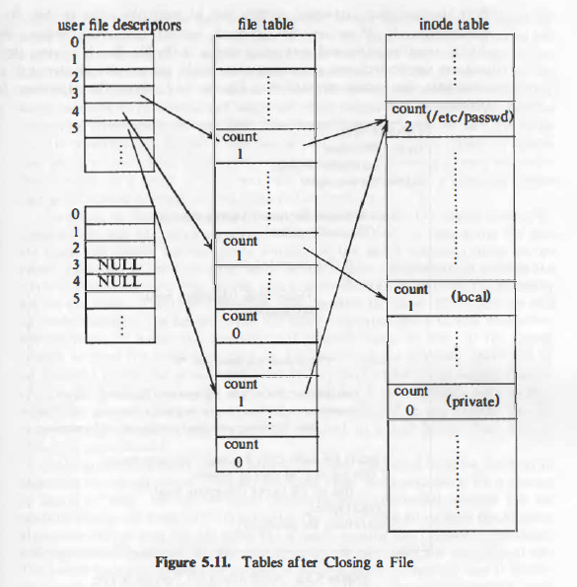
Tables after closing a file

Slide 18
Cp program

Slide 19
Cp …

